Slide 1
Lead Score Case Study
Submitted by :
Neeraj Kumar Rai
Supriya Kadam

Slide 2
Lead Score Case Study for X Education
Problem Statement :
X Education sells online courses to professionals in the sector. On numerous websites and search engines like Google, the firm advertises its courses.
When arriving at the website, these visitors may browse the courses, submit a form for the course, or watch some videos. These persons are categorized as leads when they fill out a form with their phone number or email address. Moreover, the organization also gets leads through past referrals.
Once these leads are acquired, individuals from the sales team start making calls, composing emails, etc. Some leads are converted during this procedure, but most are not. At X Education, the normal lead conversion rate is roughly 30%.
Business Goal:
In order to choose the leads that have the best chance of becoming paying clients, or the most promising prospects, X Education requires assistance.
The business needs a model where each lead is given a lead score, and leads with higher lead scores have a better chance of converting, while leads with lower lead scores have a lower chance of converting.
The desired lead conversion rate has been estimated by the CEO to be in the range of 80%

Slide 3
Strategy
Where to find the data for analysis Exploratory Data Analysis after data preparation and cleaning.
Scaling of Feature
dividing the dataset into a Train and Test dataset.
Construction of a logistic regression model and determination of Lead Score.
Assessing the model using several metrics, such as precision and recall or specificity and sensitivity.
Using the most appropriate model in test data according to the sensitivity and specificity metrics.

Slide 4
Problem solving methodology
Data Sourcing , Cleaning and Preparation
Read the Data from Source
Convert data into clean format suitable for analysis
Remove duplicate data
Outlier Treatment
Exploratory Data Analysis
Feature Standardization.
Feature Scaling and Splitting Train and Test Sets
Feature Scaling of Numeric
data
Splitting data into train and test set.
Model Building
Feature Selection using RFE
Determine the optimal model
using Logistic Regression
Calculate various metrics like accuracy, sensitivity, specificity, precision and recall and evaluate the model.
Result
Determine the lead score and check if target final predictions amounts to 80% conversion rate.
Evaluate the final prediction on the test set using cut off threshold from sensitivity and specificity metrics

Slide 5
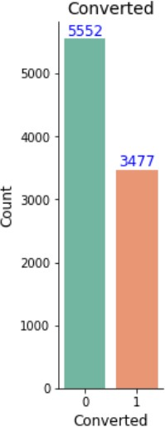
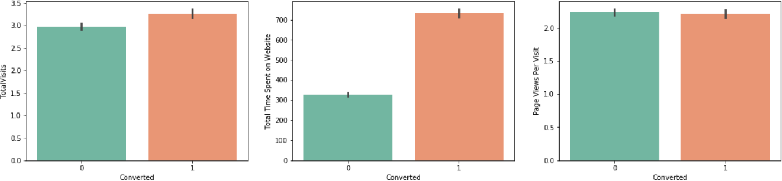
Exploratory Data Analysis
We have around 39% Conversion rate in Total
The conversion rates were high for Total Visits, Total Time Spent on Website and Page Views Per Visit
.

Slide 6
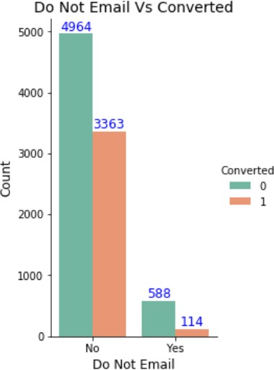
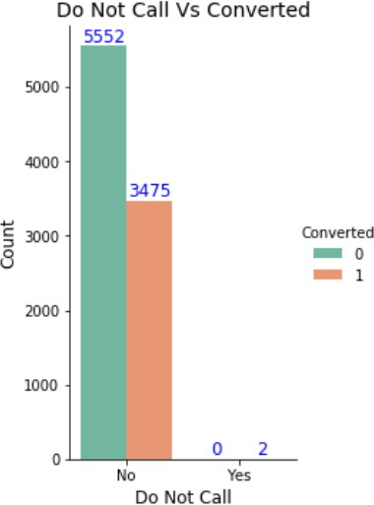
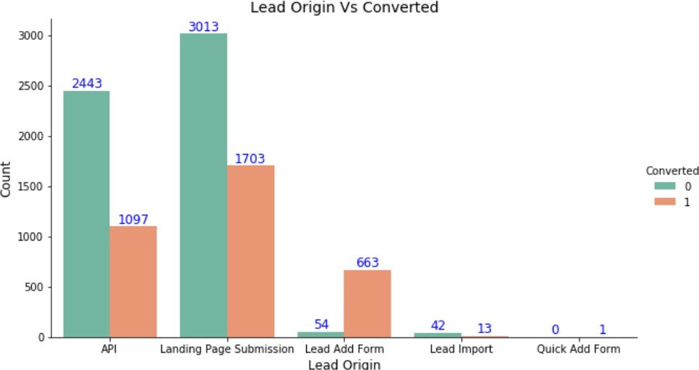
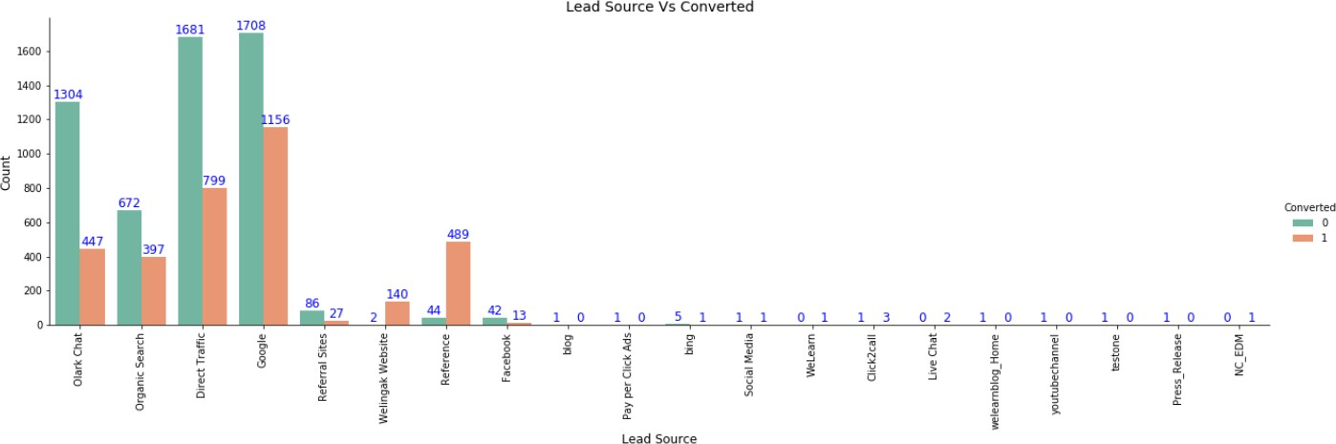
In Lead Origin, maximum conversion happened from Landing Page Submission
Major conversion has happened from Emails sent and Calls made
Major conversion in the lead source is from Google

Slide 7
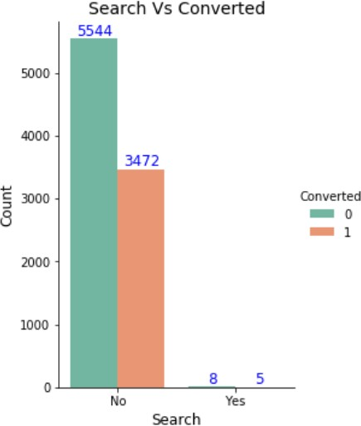
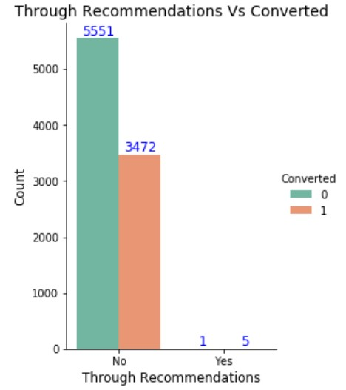
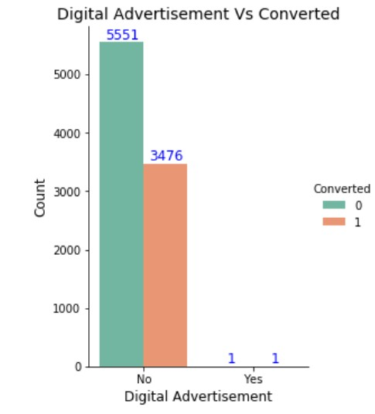
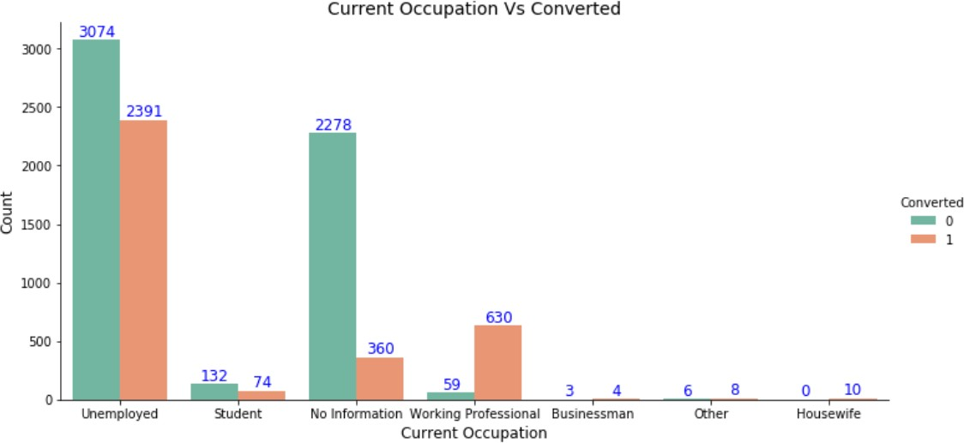
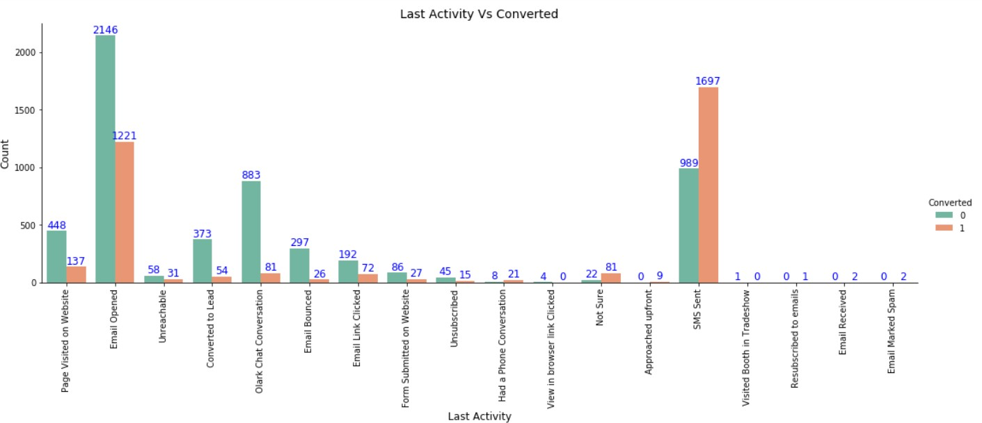
Not much impact on conversion rates through Search, digital advertisements and through recommendations
More conversion happened with people who are unemployed
Last Activity value of SMS Sent' had more conversion.

Slide 8
Variables Impacting the Conversion Rate
Do Not Email
Total Visits
Total Time Spent On Website
Lead Origin – Lead Page Submission
Lead Origin – Lead Add Form
Lead Source - Olark Chat
Last Source – Welingak Website
Last Activity – Email Bounced
Last Activity – Not Sure
Last Activity – Olark Chat Conversation
Last Activity – SMS Sent
Current Occupation – No Information
Current Occupation – Working Professional
Last Notable Activity – Had a Phone Conversation
Last Notable Activity - Unreachable

Slide 9
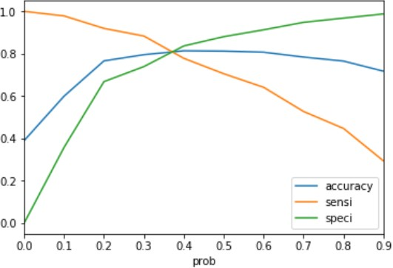
Model Evaluation - Sensitivity and Specificity on Train Data Set
The graph depicts an optimal cut off of 0.37 based on Accuracy,
Sensitivity and Specificity
Confusion Matrix
3161 697
974 1965
Accuracy - 81%
Sensitivity - 80 %
Specificity - 82 %
False Positive Rate - 18 %
Positive Predictive Value - 74 %
Positive Predictive Value – 86%

Slide 10
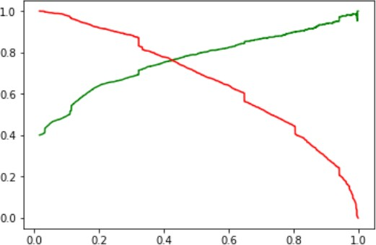
Model Evaluation- Precision and Recall on Train Dataset
The graph depicts an optimal cut off of 0.42 based on Precision and
Recall
Confusion Matrix
3397 461
725 1737
Precision - 79 %
Recall - 71 %

Slide 11
Model Evaluation – Sensitivity and Specificity on Test Dataset
Confusion Matrix
1394 300
218
797
Accuracy - 81 %
Sensitivity - 79 %
Specificity - 82 %

Slide 12
Conclusion
While we examined both Sensitivity-Specificity and Precision and Recall Metrics, we decided on the ideal cut off based on Sensitivity and Specificity for generating the final prediction. –
The test set's values for accuracy, sensitivity, and specificity are around 81%, 79%, and 82%, respectively, which are somewhat closer to the corresponding figures determined using the training set.
As determined by the lead score, the conversion rate on the final predicted model is approximately 80% (in the train set) and 79% (in the test set).
In the model, the top 3 factors that influence how many leads are converted are
Total time on site Lead Add Form from Lead Origin Phone Call from Last Noteworthy Activity
Hence overall this model seems to be good.

